Slide 1
Agentic AI
Atul Kahate
https://www.linkedin.com/in/atulkahate/

Slide 2
Module 1: Agentic AI Fundamentals and LLM Access

Slide 3

AI Agent
AI Agent: It is a system that uses AI models to perform tasks
Can perceive its environment, make decisions, and take actions in order to achieve specific goals
Capability | Definition | Examples
Perception | Takes input from the environment | Camera images, text, audio, sensor data, user queries
Reasoning / Decision-making | Decides what to do using rules, logic, or machine learning | Choosing the best move in chess, planning a route, selecting a response
Action | Performs tasks based on decisions | Moving a robot arm, answering a question, executing a command
Learning (optional) | Improves performance over time using feedback | Updating chatbot responses, refining recommendations, improving accuracy

Slide 4
Real World Need of AI Agents
Scale: Too much data, too many decisions – Humans cannot do it
Bank frauds, Cloud server management
Speed: Decisions must be instant
Stock trading, Network intrusion detection
24x7 operation: Humans need breaks – systems do not
Customer support, System monitoring
Complexity: Too many variables
Supply chain, Smart grids
Adaptability: Changing environment
Recommendation systems, Cyber attacks
Autonomy: Reduce human dependence
Auto-healing of cloud infrastructure, Robotic Process Automation (RPA)
Decision support: Not just automation
Diagnostic agents for doctors, Investment agents for investment managers

Slide 5
Traditional, Generative, Agentic AI
Aspect | Traditional AI | Generative AI | Agentic AI
Core idea | Rules and prediction | Content generation | Autonomous goal execution
Main output | Labels / scores | New content | Actions and outcomes
Creativity | None | High | Moderate–High
Autonomy | Low | Low–Medium | High
Goal handling | Fixed objectives | Prompt-driven | Plans and sub-goals
Interaction | Predefined inputs | Prompts | Continuous loop
Tool usage | Minimal | When prompted | Self-selected and orchestrated
Memory | Minimal | Context-based | Short + long-term
Adaptability | Low | Medium | High
Human involvement | High | Medium | Low
Examples | Spam filter | ChatGPT | Auto-GPT / LangGraph
Use cases | Prediction | Content creation | Automation and decision-making

Slide 6
Agent Types
Reactive Agent: Sense -> Act (No planning)
Respond immediately to the current environment
No memory of past actions
No future planning
Rule-based bots, Simple if-else systems
Example: When an input file is received, process it and create a report
Proactive Agents: Gola-driven Behavior
Act to achieve specific goals
Can plan ahead
May consider future states
Planning agents, Goal-based decision systems
Example: A stock market agent that alerts you to sell a stock because price may fall
Autonomous Agents: Self-directed and Adaptive
Operate independently without constant human control
Learn from experience
Combine reactive + proactive behavior
Example: A research agent finds out the best sources of information, handles failures, and comes up with a report

Slide 7
Summary: Agent Types
Feature | Reactive | Proactive | Autonomous
Decision style | Immediate response | Goal-oriented | Self-directed
Planning | No | Yes | Yes
Learning | No | Sometimes | Yes
Human control | High | Medium | Low
Adaptability | Low | Medium | High

Slide 8

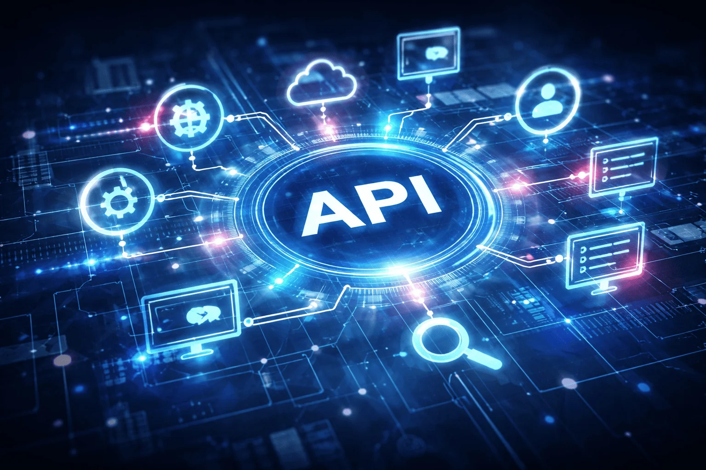



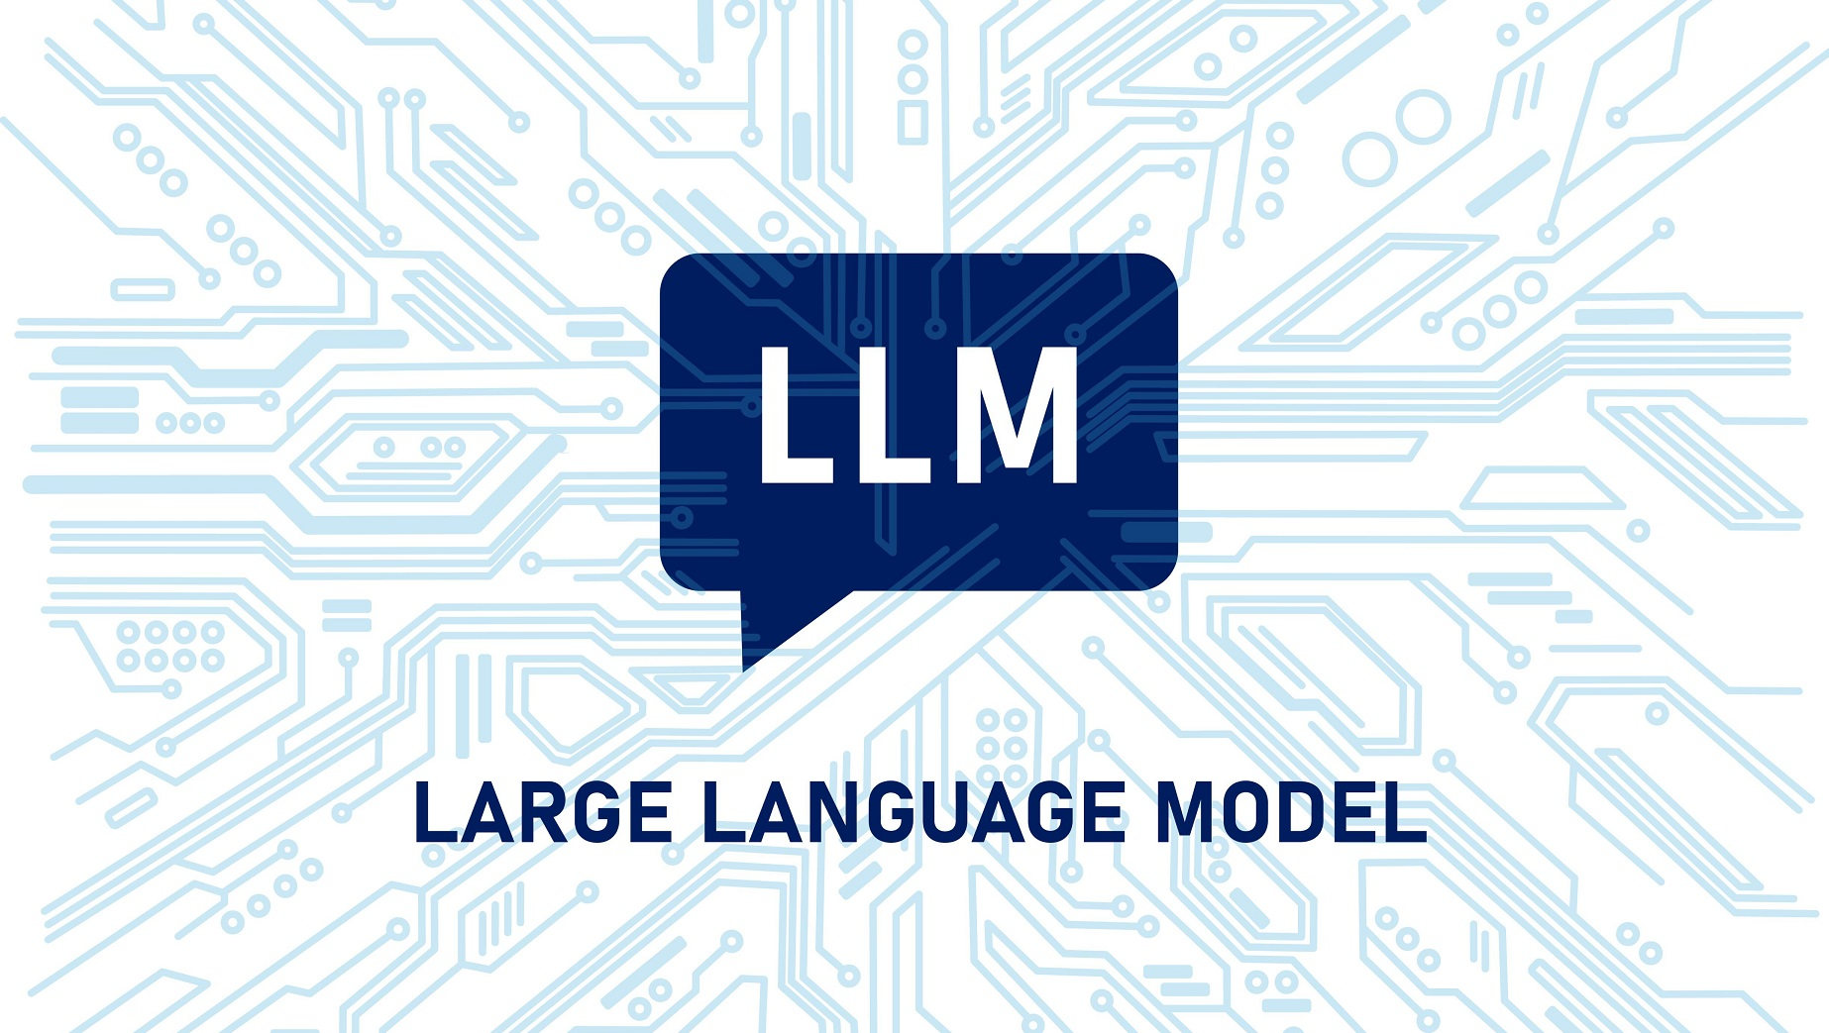
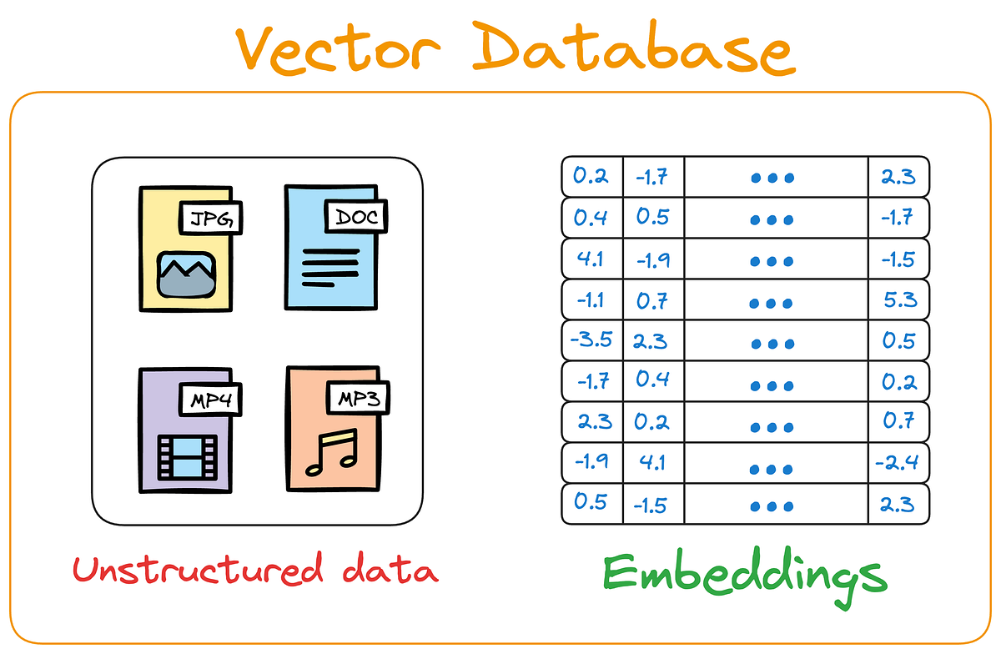



Foundational Components of an AI Agent
MCP
Instructions in a Natural Human Language
Think, Act, Review
Tool Calling
RAG
Guardrails
HITL
Memory
This Photo by Unknown Author is licensed under CC BY-ND

Slide 9
Industry Trends
General Trends (https://congruentx.com/emerging-trends-in-agentic-ai-for-2025)
Shift from Assistants to Autonomous Workflows (https://timesofindia.indiatimes.com/technology/tech-news/onix-2026-ai-trends-multi-agent-systems-redefine-enterprise-workflows/articleshow/126487254.cms)
Agentic Commerce Takes Off (https://www.investors.com/news/technology/shopify-stock-nrf-news-ai-agentic-shopping/)

Slide 10
Hands-on: Directly Accessing LLMs
Download and install Python Version 3.12 (https://www.python.org/downloads/)
Download and install VS Code (https://code.visualstudio.com/download)
Create a directory (e.g. c:\code\agenticai_realpage) on your machine
Set up Python in VS Code: Open VS Code and press Ctrl+Shift+P -> Python: Select interpreter -> Select Python that you have installed on your machine
Create a virtual environment in VS Code
Terminal -> New Terminal -> cd c:\code\agenticai_realpage
python -m venv myenv
myvenv\Scripts\activate (On Windows) and source myvenv/bin/activate (on Linux)
pip install openai openai-agents
Later to deactivate: deactivate

Slide 11
Using LLMs: OpenAI
Get an API key: https://platform.openai.com/settings/organization/api-keys
Copy it in .env file
pip install openai dotenv
Run C:\code\agenticai_realpage\module_1\1_openai_basic.py

Slide 12
Building the First Agent
Step 1: Setup and Imports
Code | Explanation
load_dotenv() | Loads API keys from .env file
OpenAI() | Instantiate an object of OpenAI class
from openai import OpenAI
from dotenv import load_dotenv
load_dotenv(override=True)
client = OpenAI()

Slide 13
Building the First Agent
Step 2: Call the LLM
Code | Explanation
create | Create a call to the LLM using the OpenAI Chat Completions API
model | Which LLM to use
messages | system: Set the persona user: A specific question/problem
response | What the LLM returns
response = client.chat.completions.create(
model="gpt-4o-mini",
messages=[
{"role": "system", "content": "You are a helpful assistant"},
{"role": "user", "content": "Explain agentic AI in one paragraph"}
]
)
print(response.choices[0].message.content)

Slide 14
Using LLMs: Hugging Face
Open source models
We have full control
Offline / On-prem
No vendor lock-in
Very slow, sometimes
Two options
Transformers API (Local/GPU/CPU): pip install transformers torch accelerate
We download and run the model inside our environment
Hugging Face Interface API (Hosted): pip install huggingface_hub
Model runs on Hugging Face cloud infrastructure
Code: module_1\2_hugging_face_local.py
Will not run, unless we make a payment on Hugging Face site to enable inference endpoints (endpoints.huggingface.co)

Slide 15
Creating a Simple Utility Agent Using OpenAI API (No Frameworks)

Slide 16
Building a Multi-Assistant Agent Step-by-Step
Step 1: Setup and Imports
import asyncio
from agents import Agent, Runner, function_tool
from datetime import datetime
from dotenv import load_dotenv
load_dotenv(override=True)
Code | Explanation
agents | OpenAI Agents SDK
asyncio | For running multiple queries concurrently
function_tool | Decorator to convert functions into agent tools
load_dotenv() | Loads API keys from .env file
Installations
pip install openai-agents dotenv

Slide 17
Building a Multi-Assistant Agent Step-by-Step
Step 2: Create Tools
@function_tool
def get_temperature(city: str) -> str:
"""Returns mock temperature for a city."""
temps = {
"new york": "72°F",
"london": "65°F",
"tokyo": "78°F",
"sydney": "68°F",
"mumbai": "85°F"
}
return temps.get(city.lower(), "70°F")
Code | Explanation
@function_tool | Decorator tells the agent that it is a callable tool
“”” … ‘’’ | Docstring helps the agent decide if and when to use this tool

Slide 18
Building a Multi-Assistant Agent Step-by-Step
Step 2: Create Tools
@function_tool
def get_time(timezone: str) -> str:
"""Returns current time for a timezone."""
return datetime.now().strftime("%I:%M %p")
@function_tool
def calculate(expression: str) -> str:
"""Evaluates a simple math expression."""
try:
result = eval(expression)
return f"{expression} = {result}"
except:
return "Invalid expression"

Slide 19
Building a Multi-Assistant Agent Step-by-Step
Step 3: Create Agent
agent = Agent(
name="QuickAssistant",
model="gpt-4o-mini",
tools=[get_temperature, get_time, calculate],
instructions="You are a helpful assistant. Use tools when needed. Be concise."
)
Code | Explanation
name | Identifies the agent
model | Which LLM to use?
tools | List of available tools
instructions | System prompt

Slide 20
Building a Multi-Assistant Agent Step-by-Step
Step 4: Prepare Test Queries
async def run_agent():
queries = [
"What's the temperature in Tokyo?",
"Calculate 25 * 4 + 10",
"What time is it in New York timezone?",
]
print("Processing queries in parallel...\n")
Code | Explanation
queries | List of queries to be sent to the agent
async def | Run this concurrently
Queries are in natural (human) language
Agent will figure out if and which tool to call

Slide 21
Building a Multi-Assistant Agent Step-by-Step
Step 5: Run Queries Concurrently
# Process all queries concurrently
tasks = [Runner.run(agent, query) for query in queries]
results = await asyncio.gather(*tasks)
Code | Explanation
Runner.run(agent, query) | Executes agent with a query, [ ] creates a list comprehension, i.e. multiple tasks
asyncio.gather() | Runs all tasks simultaneously and waits for all to complete
await | Waits for all results before continuing

Slide 22
Building a Multi-Assistant Agent Step-by-Step
Step 6: Display Results
# Display results
for query, result in zip(queries, results):
print(f"Q: {query}")
print(f"A: {result.final_output}\n")
Code | Explanation
zip() | Pairs each query with its result
result.final_output | Agent’s final answer, after all tool calls

Slide 23
Building a Mult-Assistant Agent Step-by-Step
Step 7: Run the Program
if __name__ == "__main__":
asyncio.run(run_agent())
Code | Explanation
if __name__ == “__main__”: | Standard Python syntax – Only runs if the file is executing directly
asyncio.run() | Starts the async event loop and runs main()

Slide 24
LangChain

Slide 25
LangChain
LangChain: A framework for building applications powered by Large Language Models (LLMs) by connecting them with external data, tools, and workflows
Features
Load data from different sources
Reason over that data using LLMs
Build reliable, production-ready AI systems

Slide 26
Loaders in LangChain
Loaders: Components that read data from a source and convert it into Documents that LLMs can understand
PDFs, Word documents, Website data, Databases are loaded into a standard format
Document(
page_content="text",
metadata={...}
)
Popular built-in loaders: TextLoader, PyPDFLoader, CSVLoader, etc
Code: module_2\2_langchain_load_pdf.py

Slide 27
LangChain Embeddings – RAG and Vector Databases

Slide 28
What is RAG?
Concept | Explanation
Frozen Knowledge | LLMs are trained to have knowledge up to a specific date
Hallucination | A situation where a generative AI model (LLM) does not know the correct answer and produces incorrect, made-up, or nonsensical information
Why? | LLMs cannot answer questions about information they were not trained on or that is missing/incorrect in their training data
Why RAG? | RAG provides external, up-to-date, factual information to the LLM so it can answer accurately “RAG starts where generative AI ends”
RAG Parts | Retriever: Fetches relevant documents from external sources (e.g., Pinecone, Chroma, LlamaIndex, Activeloop) Generator: The LLM that uses the retrieved context to generate accurate answers

Slide 29
Agentic RAG
Aspect | Traditional RAG | Agentic RAG
Core idea | Retrieve then generate | Agent decides how and when to retrieve
Control flow | Fixed pipeline | Dynamic, decision-driven
Retrieval steps | Single retrieval | Multiple, iterative retrievals
Reasoning | Minimal | Explicit reasoning and planning
Autonomy | Low | High
Tool usage | Retriever only | Retriever + tools
Memory | Limited context | Short-term and long-term memory
Error handling | None | Reflection and self-correction
Query refinement | Manual | Automatic
Multi-source retrieval | Limited | Supported
Example | FAQ chatbot | Research assistant agent

Slide 30
Embedding and Vector
Embedding: A technique to represent information (text, image, audio, video) as a list of numbers such that similar items have vectors that are close to each other in high-dimensional space
How? Convert information (text, image, audio, video) into a vector (list of numbers)
Example
Original text: “Cute dog”
Embedding: [0.02134, -0.00312, 0.01579, 0.09821, -0.04412, …]
The entire vector captures semantic meaning in a compressed way, i.e. individual numbers are not interpretable
Distances between embeddings reflect similarity
One Embedding = One Vector
How similar are two vectors? (1) Cosine Similarity, (2) Euclidean Distance

Slide 31
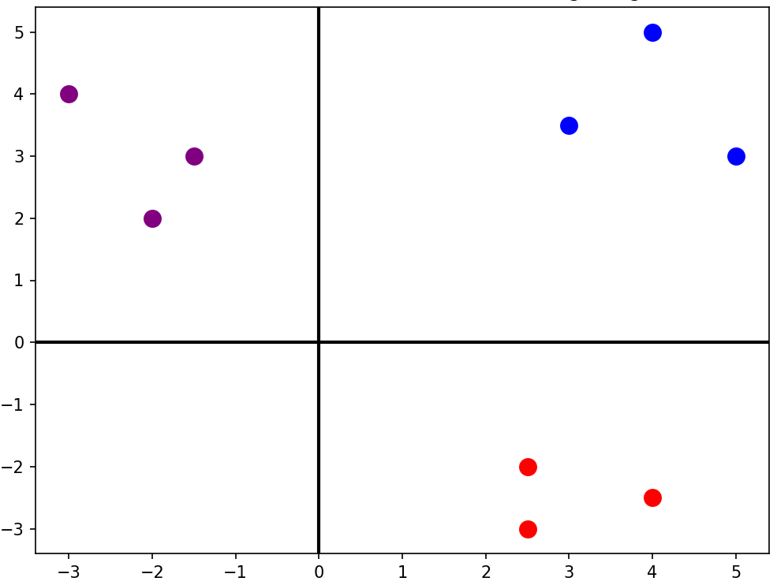
2D Vector Embeddings Example
king [4 5]
man [3 3.5]
woman [5 3]
apple [2.5 -2]
banana [2.5 -3]
orange [4 -2.5]
football [-3 4]
golf [-1.5 3]
tennis [-2 2]

Slide 32
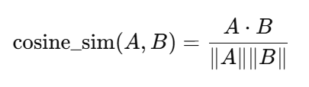
Cosine Similarity
Imagine two arrows starting from the same point
Cosine similarity: Measures how aligned two vectors are, not how far apart they are
Answers questions: Do these vectors point in the same semantic direction?
Vector Direction Relationship | Intuitive Meaning | Angle Between Vectors | Cosine Value
Pointing in the same direction | Very similar | 0° | 1
Pointing at right angles | Unrelated / Orthogonal | 90° | 0
Pointing in opposite directions | Opposites | 180° | −1

Slide 33
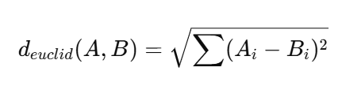
Euclidean Distance
Think of vectors as points
Euclidean distance measures
Physical distance
Geometric closeness
Works exactly like measuring distance in a map
Less distance = More similar
Feature | Euclidean Distance | Cosine Similarity
Measures | Straight-line distance | Angle between vectors
Sensitive to magnitude | Yes | No
Semantic similarity | Sometimes | Best
Used in NLP search | Rarely | Common

Slide 34
Why Cosine Similarity is Better in NLP?
In NLP, we care about meaning direction, not sentence size
Step | Details
1) What Embedding actually is | An NLP embedding vector model contains: Direction = Meaning Length (Magnitude) = How much information / How verbose Think of vectors like arrows: Same direction = Same meaning Longer arrow = More words / emphasis / details
2) What Euclidean Distance actually measures | Euclidean Distance answers: How far apart are the arrow tips Summary: It cares about length and absolute path, not direction Problem for NLP: Two sentences with the same meaning but different lengths end up far apart
3) NLP Example | Sentence A (Short): Apply for Loan Sentence B (Long): I would like to apply for a personal loan as soon as possible Result: Euclidean Distance between them is large, so the model thinks they are “different”, which is a mistake

Slide 35
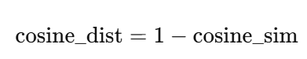
Euclidean Distance vs Cosine Distance
Basic difference: Magnitude versus Direction
Metric | What it measures
Euclidean distance | How far apart two vectors are in space
Cosine distance | How different their directions (angles) are
Vector DB | Default
Chroma | Cosine
FAISS (NLP) | Cosine / Inner Product
Pinecone | Cosine
Weaviate | Cosine
OpenAI embeddings | Cosine
Same direction, different length
A = (10, 10)
B = (1, 1)
Cosine similarity ≈ 1.0 (same meaning)
Euclidean distance = large
Different direction, same length
A = (10, 0)
B = (0, 10)
Cosine similarity = 0
Euclidean distance = same as earlier case

Slide 36
Code Examples
Basics of Cosine Similarity and Euclidean Distance -> C:\code\agenticai_realpage\module_2\2_langchain_basic_rag_cosine_euclidean_1.py
Why Cosine Similarity is better ->
C:\code\agenticai_realpage\module_2\2_langchain_basic_rag_cosine_euclidean_1.py

Slide 37
Embedding Models
Model Name | Provider | Key Features (Simple Words) | Typical Dimensions
text-embedding-3-small | OpenAI | Fast, cheap, good for search and clustering | 1536
text-embedding-3-large | OpenAI | Highest accuracy, best semantic understanding | 3072
all-MiniLM-L6-v2 | Hugging Face / Sentence Transformers | Very fast, small, good for local use; widely used | 384
all-mpnet-base-v2 | Hugging Face / Sentence Transformers | High quality semantic search; great balance of speed + accuracy | 768
bge-small-en | Hugging Face (BAAI) | Very fast, optimized for retrieval tasks | 384
bge-base-en | Hugging Face (BAAI) | Strong semantic retrieval; good general-purpose model | 768
bge-large-en | Hugging Face (BAAI) | Very high accuracy; heavier to run | 1024
e5-small-v2 | Hugging Face (Microsoft) | Lightweight; very good for embeddings in search tasks | 384
e5-base-v2 | Hugging Face (Microsoft) | Strong performance for retrieval, question–answering | 768
instructor-xl | Hugging Face (HKU + Meta) | Instruction-based embeddings (you can tell the model what to focus on) | 768 / 1024+
Concept | Meaning | Example
Embedding Model | An AI model that creates these vectors | OpenAI “text-embedding-3-small”
Dimension | How many numbers are in each vector | 1536 numbers, 3072 numbers, etc.
Similarity | How close two vectors are in meaning | “cat” vector ≈ “kitten” vector
Distance | Mathematical gap between two vectors | Small distance → similar meaning
Vector Space | The “map” where all vectors live | Similar ideas group together in space
Use Cases | What embeddings are used for | Search, recommendations, clustering
“Cute dog”
Embedding model
[0.02134, -0.00312, 0.01579, …]

Slide 38
Vector Databases
Vector DB | Type | Best For | Pros | Cons
ChromaDB | Local / Embedded | Small–medium apps, notebooks, prototyping | Easy to use, local persistence, Python-friendly | Not ideal for very large scale
FAISS | Library (not a DB) | Fast similarity search inside apps | Very fast, offline, highly optimized | No metadata store, no server mode
Pinecone | Fully-Managed Cloud | Production-grade large-scale search | Scalable, high availability, no infra needed | Paid, cloud-only
Weaviate | Open-source + Cloud | Semantic search with metadata | Hybrid search, schema, GraphQL API | More complex setup
Milvus | Open-source + Cloud | Heavy workloads, millions of vectors | Highly scalable, rich index options | Requires infrastructure management
Qdrant | Open-source + Cloud | Production apps with filters | Fast, good filtering, simple API | Slightly heavier setup locally
Redis Vector Store | Add-on to Redis | Apps already using Redis | Fast, real-time similarity | Requires Redis, not specialized

Slide 39



Vector Database (Code: C:\code\agenticai_realpage\module_2\2_langchain_vector_db_chroma.py )
Vector database
Embedding
$$\left[−0.05, −0.0955, …, −0.0722\right]$$
Embedding
$$\left[−0.068, −0.0255, …, −0.1222\right]$$
. . .
. . .
Embedding
$$\left[−0.023, −0.0412, …, −0.0003\right]$$
Text splits

Slide 40
Chains
Chain: Sequence of calls to components
In the early days of LangChain, these were "pre-built" classes (like RetrievalQA), but modern LangChain uses a more flexible approach
Take an Input (User Question) → process it (Retrieval) → pass it to a Prompt → send it to an LLM → get an Output
Legacy vs. Modern: While "Chains" is the general term for the workflow, most developers have moved toward LCEL (LangChain Expression Language) for better control
Example
chain = prompt | model | output_parser
response = chain.invoke({"topic": "black holes"})

Slide 41
LCEL
LangChain Expression Language (LCEL): Modern, declarative way to build and customize chains in LangChain
Replaces the older, "hidden" logic of legacy classes like LLMChain or RetrievalQA
Treats every component (prompts, models, retrievers, parsers) as a "Runnable" that can be snapped together

Slide 42
Runnables and LCEL
Runnables: Building blocks of the LangChain Expression Language (LCEL)
"Runnable" is a standard interface that allows us to "pipe" components together using the | operator
Pipe Operator (|): Behaves like a Unix pipe and takes the output of the left side and feeds it as the input to the right side
Why use it? It automatically handles things like:
Async: Running tasks in the background
Batch: Processing multiple inputs at once
Streaming: Seeing the AI's response character by character
Code: module_2\2_langchain_lcel_runnable.py, module_2\2_langchain_multiple_streaming.py

Slide 43
LangServe
LangServe: Official way to turn our LangChain runnables and chains into a REST API
Built on top of FastAPI
Automatically handles the complex parts of deployment, like schema validation, multiple endpoints (/invoke, /batch, /stream), and even a built-in interactive playground
We register our LangChain code and register with a path – LangServe creates
API endpoints
Schema (Automatic JSON validation using Pydantic)
Playground to test the chain

Slide 44
LangServe: How to Use?
Create deployment code and run it: C:\code\agenticai_realpage\module_2\2_langchain_server.py
To test, browser: http://localhost:8000/note/playground/
Through code: C:\code\agenticai_realpage\module_2\2_langchain_test_server.py
To run, Terminal -> New Terminal Window and then run it

Slide 45
Build a Q&A Bot from PDFs
Chroma DB, Insurance example: C:\code\agenticai_realpage\module_2\2_langchain_qand_a_bot_chroma.py
Test: Browser - http://localhost:8000/ask/playground/
FAISS: C:\code\agenticai_realpage\module_2\2_langchain_qanda_bot_faiss.py
Test: Browser - http://localhost:8000/ask/playground/
While Chroma manages a directory of files automatically, FAISS typically saves to a single .index file along with a .pkl for the documents
In LangChain, we use save_local and load_local for this

